Slide 1
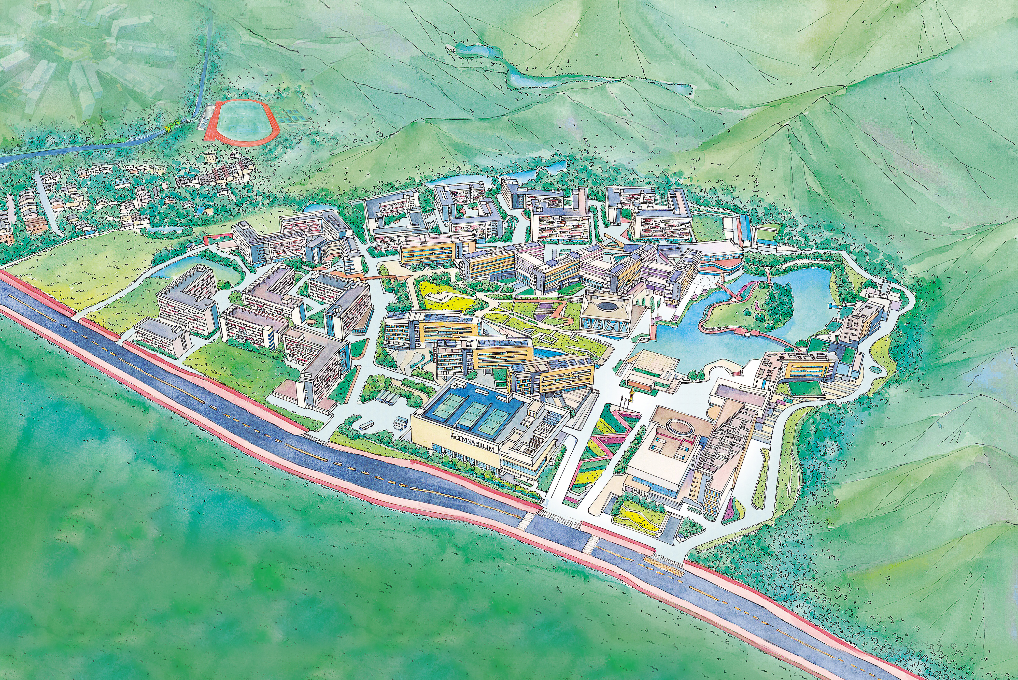
Programme Transfer
By Academic Registry
24 Oct 2023

Slide 2

CONTENTS
01
Application for Programme Transfer
02
Rules of Unit Transfer
03
Risk of Programme
Transfer

Slide 3

Preparation
Reflect on your true interests, academic strengths and career goals
Consult faculty members, fellow students and parents
Take the introductory courses:
Course Selection
Course Add/Drop
Summer Programmes (UIC/HKBU/Overseas)

Slide 4

01
Application for Programme Transfer
Basic Requirement
Programme
Information
How to Apply
1) Non-final year students;
2) Normally expected cGPA≥2.0;
3) Student is allowed to change
his/her study programme
only once during four-year
study;
4) More details please refer to
AR Website (General
Regulations)
Musical Arts Programme is
not eligible to apply for
programme transfer
Student can select one programme only
Online application procedure:
Submit Online Application
Faculty/School Review (GPA)
Art & Design Portfolio Assessment (normally required by AIM, CTV and MAD)/Interview (if needed)
Result Release & Confirmation of Transfer

Slide 5

Programme Information
Faculty/School | Abbreviation | Abbreviation | Current offered Study Year (exclude Yr-4)
FBM | ACCT | 会计学 | Yr 1-3
 | AE | 应用经济学
 | FIN | 财务学
 | EBIS | 电子商务与资讯系统管理
 | EPIN | 创业与创新管理
 | MHR | 人力资源管理
 | MKT | 市场营销管理
 | BUSA | 商业分析 | Yr 1
 | DMM | 数字媒体管理
SCC | AIM | 动画与互动媒体 | Yr 1-3
 | CTV | 影视学
 | CCM | 文化创意与管理
 | MAD | 媒体艺术与设计
 | THEM | 旅游、酒店与会展管理
 | MUS | 音乐艺术 | Not eligible to apply
Faculty/School | Abbreviation | Abbreviation | Current offered Study Year (exclude Yr-4)
FHSS | CCGC | 中华文化与国际传播 | Yr 1-3
 | MCOM | 媒体与传播学
 | PRA | 公共关系与广告学
 | ATS | 应用翻译学
 | ELLS | 英语语言文学
 | GAD | 全球化与发展
 | DGS | 数字社会科学 | Yr 1-2
FST | AM | 应用数学 | Yr 1-3
 | FM | 金融数学
 | DS | 数据科学
 | STAT | 统计学
 | AI | 人工智能
 | CST | 计算机科学与技术
 | APSY | 应用心理学
 | ENVS | 环境科学
 | FS | 食品科学与工程
If the application is approved, the receiving programme will decide to admit the student to the year of study which is considers appropriate.

Slide 6
Programme Transfer Schedule of AY2023-24
转专业申请系统 https://p.uic.edu.cn/ 开放时间 |  | 适用年级 (2023/24学年) | 衡量标准 | 审核通过 学生名单 公示时间 | 新专业 生效学期 | 课程类别更新与学分置换 (请留意 教学事务组 的邮件通知) | 调整课表 (请留意 课程注册组 的邮件通知)
第一轮 | 2023年10月27日 (10:00) 至 2023年11月17日 (10:00) | 大二、大三 | 2022/23学年第二学期的 累计平均学分绩点(cGPA) | 2023年 12月中旬 | 2023/24学年第二学期 | 2023年 12月下旬 | 2024年1月上旬
第二轮 | 2024年3月 | 大一、大二、大三 | 2023/24学年第一学期 累计平均学分绩点(cGPA) | 2024年 4月底 | 2024/25学年 第一学期 | 2024年 7月上旬 | 2024年 8月上旬

Slide 7

02
Rules of Unit Transfer
Course Category
Course Category | For Extra Courses
MR | will be changed to FE
ME
FE | 1) will remain as FE or, 2) will be changed to MR/ME if the course is MR/ME for the transfer-in programme
UC | will remain as UC
GE2021 | will remain as GE2021
Abbreviations:
MR- Major Required Courses
ME- Major Elective Courses
FE- Free Elective Courses
UC- University Core Courses
GE2021- General Education Courses
Detail please refer to AR Website – Current Students – Programme Transfer –Unit Transfer
(https://ar.uic.edu.cn/current_students/programme_transfer/unit_transfer.htm)

Slide 8

Check Your Graduation Audit Report (GAR)
- Except Yr 1 students
学期 | 毕业核查报告 开放时间
2023/24学年第一学期 | 2023年6月16日 (10:00) 至 2023年12月22日 (16:00)
 | 2024年1月19日重开（暂定)

Slide 9
Transcript of Academic Record
Explanation of
Symbols and Notations
Before transfer
*: S/U grading scheme, Unit(s) counted
but not included in GPA calculation
After transfer
#: Course transferred to new study programme
*#: S/U grading scheme, Unit(s) counted
but not included in GPA calculation,
course transferred to new study programme

Slide 10
Transcript for example

Slide 11

Understand
the Risk and Change
03
03
01
“Tailor-made” Four-Year Study Plan
Make-up Courses
Pre-requisite requirements
02
Repeat a Year
03
Concessional Year

Slide 12

Study in New Programme
Refer to Undergraduate Handbook
Refer to Curriculum Requirement
Refer to Course Offer/Study Sequence (Four-Year Study Plan)
Make course adjustment via Course Selection
Make course adjustment via Course Add/Drop

Slide 13


Sharing
Ms. LI Yaru

Slide 14

Contact Information
Enquiries for:
Programme Transfer: ar_record@uic.edu.cn
Unit Transfer: academicsuccess@uic.edu.cn
Course Registration: ar_course@uic.edu.cn

Slide 15
THANK YOU

